Slide 1
EC3290 – Software Requirements Engineering
Topic 1 – Introduction to Requirements Engineering
CLO 1
4 Hours

Slide 2
Introduction to Software Engineering
Definition: Software engineering is the application of engineering principles to the development, operation, and maintenance of software systems. It involves a systematic, disciplined, and quantifiable approach to software development, ensuring high quality and efficiency.
Key Components:
Processes: These are structured sequences of activities that guide software development, such as planning, analysis, design, implementation, testing, and maintenance. Processes ensure a systematic approach and are often tailored to project needs.
Tools: Software tools are used to support processes and methodologies. Examples include integrated development environments (IDEs), version control systems, and testing frameworks.
Methodologies: These are frameworks that dictate how processes are implemented. Examples include Agile, Waterfall, and DevOps. Methodologies help teams align on goals and strategies throughout the project lifecycle.

Slide 3
Software Development Lifecycle (SDLC) Overview
Planning
Analysis
Design
Implementation
Maintenance

Slide 4
Importance of Processes in Software Development
Ensures Consistency and Quality: Well-defined processes help maintain consistency across teams and projects. By following standard procedures, teams can deliver software that meets quality expectations and adheres to best practices.
Manages Complexity and Reduces Risks: Software development often involves handling complex systems and technologies. Processes help break down these complexities into manageable steps and identify potential risks early, allowing teams to mitigate them proactively.
Facilitates Communication Among Stakeholders: Processes provide a common framework and terminology for developers, project managers, clients, and other stakeholders. This fosters better collaboration, clearer expectations, and alignment on project goals.

Slide 5
Relationship Between Software Processes and Requirements
Foundation of Subsequent Phases: Requirements serve as the cornerstone of software development. They define what the software must do and set the scope of the project. All subsequent phases—design, implementation, testing, and maintenance—rely on accurate and comprehensive requirements.
Impact of Poor Requirements: Ambiguous, incomplete, or incorrect requirements can lead to misaligned development efforts, increased costs, and delays. In worst-case scenarios, poor requirements can result in the complete failure of a project.
Processes to Improve Requirement Quality:
Requirement Elicitation: Engaging stakeholders through interviews, surveys, and workshops to gather detailed requirements.
Requirement Validation: Ensuring requirements are clear, consistent, and feasible before moving to the design phase.
Requirement Management: Continuously tracking and updating requirements throughout the project lifecycle.

Slide 6
Definition of Requirements Engineering
Definition: Requirements engineering is the systematic process of identifying, documenting, and maintaining software requirements. It ensures that the software being developed aligns with user needs and business goals. This process is iterative and involves continuous interaction with stakeholders.
Key Activities in Requirements Engineering:
Elicitation: Gathering requirements from stakeholders through interviews, surveys, observation, and workshops.
Documentation: Structuring the gathered requirements into clear, unambiguous, and verifiable documents, such as Software Requirement Specifications (SRS).
Validation: Ensuring that requirements are complete, feasible, and correctly understood by all parties.
Management: Maintaining and updating requirements throughout the software development lifecycle to address changes and evolving needs.

Slide 7
Role of Requirements Engineering
Bridges the Gap Between Stakeholders and Developers: Requirements engineering acts as a mediator to translate stakeholder needs into technical specifications. It ensures that developers understand what the stakeholders want and why it’s important.
Establishes a Clear Understanding of Project Goals: By defining and documenting requirements upfront, all project participants—stakeholders, developers, testers, and managers—gain a shared understanding of the project’s objectives and scope.
Supports Decision-Making: Well-defined requirements provide a basis for making informed decisions during the project, such as prioritizing features or resolving conflicts between stakeholder expectations.
Enhances Collaboration: It creates a structured process for continuous communication between the technical and non-technical members of the project team.

Slide 8
Importance of Requirements Engineering
Prevents Scope Creep: Requirements engineering helps in clearly defining the project scope, preventing uncontrolled expansion of features or functionality during development. This ensures the project stays on track and within budget.
Reduces Development Costs and Time: Addressing and refining requirements early in the project lifecycle helps identify potential issues and misunderstandings, reducing costly rework during later stages.
Improves Software Quality and User Satisfaction: By focusing on user needs and expectations, requirements engineering ensures that the delivered software is both functional and user-friendly, leading to higher satisfaction and usability.
Minimizes Risks: A clear understanding of requirements helps identify risks early, such as technical feasibility or conflicts between stakeholder priorities, enabling better risk management strategies.
Ensures Compliance: For industries with regulatory requirements, the process ensures that all necessary standards are met.

Slide 9
Challenges in Requirements Engineering
Changing Requirements: Stakeholders’ needs may evolve over time due to market changes, new business goals, or feedback from early stages of development. Managing these changes while minimizing their impact is a significant challenge.
Ambiguities and Misunderstandings: Requirements may be written or communicated in a way that is unclear, leading to differing interpretations by stakeholders and developers.
Communication Gaps Among Stakeholders: Stakeholders may have conflicting goals or use different terminology, making it challenging to align their expectations.
Limited Stakeholder Involvement: If stakeholders are not actively engaged in the requirements process, critical needs may be overlooked or misunderstood.
Technical Feasibility Issues: Some requirements may not be technically or financially feasible, requiring negotiation and adjustment to align with constraints.

Slide 10
Challenges in Requirements Engineering
Addressing These Challenges:
Use clear, unambiguous language and visual aids like diagrams.
Involve stakeholders continuously throughout the process.
Employ requirement management tools for tracking changes.
Conduct regular validation sessions to ensure alignment among all parties.

Slide 11
Overview of Requirements Engineering Activities
Requirements Engineering Activities:
Elicitation: The process of gathering requirements from stakeholders to understand what the system should do.
Analysis: Understanding, refining, and prioritizing requirements to ensure they are feasible and align with project goals.
Specification: Documenting requirements in a structured format to serve as a reference for all project phases.
Validation: Verifying that the documented requirements meet user needs and are complete, consistent, and feasible.
Management: Handling changes to requirements throughout the project lifecycle to ensure alignment with evolving needs.

Slide 12
Elicitation
Definition: Elicitation is the process of gathering and discovering requirements from stakeholders and other sources. It is the foundation of requirements engineering and involves active engagement with stakeholders.
Techniques:
Interviews: Conducting one-on-one or group discussions to understand stakeholder needs and expectations.
Surveys and Questionnaires: Distributing structured forms to collect information from a larger group of stakeholders.
Brainstorming Sessions: Facilitating collaborative sessions to generate ideas and uncover hidden needs.
Document Analysis: Reviewing existing documentation, such as business plans or system manuals, to extract relevant requirements.

Slide 13
Analysis
Definition: Analysis involves understanding, refining, and organizing elicited requirements to ensure they are feasible, consistent, and aligned with project goals.
Key Activities:
Identifying Dependencies: Understanding how different requirements are related and ensuring no conflicts exist between them.
Prioritizing Requirements: Categorizing requirements based on their importance and urgency to stakeholders. Techniques like the MoSCoW method (Must have, Should have, Could have, Won't have) are often used.
Feasibility Assessment: Ensuring that the requirements can be achieved within the project’s technical, financial, and time constraints.

Slide 14
MoSCoW Method – Must Have
Definition: These are the requirements that are critical to the success of the project. Without them, the system cannot function, and the project would be considered a failure.
Characteristics:
Essential for achieving business goals or meeting legal and regulatory requirements.
Directly impacts the system's core functionality.
Examples:
A banking app must have secure login functionality.
An e-commerce website must have a shopping cart feature.

Slide 15
MoSCoW Method – Should Have
Definition: These are important requirements but not critical for immediate success. They are often considered high-priority but not mandatory for the first release.
Characteristics:
Adds significant value but can be deferred if necessary.
May be included if time and resources permit.
Examples:
A system should have multiple language support.
A project management tool should have integration with other tools like Slack or Teams.

Slide 16
MoSCoW Method – Could Have
Definition: These are desirable but not essential requirements. They have a lower priority and are often included if time, budget, and resources allow.
Characteristics:
Nice-to-have features that enhance user experience.
Does not impact core functionality or business goals.
Examples:
A mobile app could have a dark mode.
A website could have animated transitions between pages.

Slide 17
MoSCoW Method – Won’t Have
Definition: These are requirements that are agreed to be out of scope for the current project or release but may be considered for future iterations.
Characteristics:
Explicitly documented to avoid confusion or scope creep.
Can be revisited in later phases or versions.
Examples:
A system won’t have voice recognition in the initial release.
A website won’t have augmented reality features in Phase 1.

Slide 18
Specification
Definition: Specification involves documenting the requirements in a clear, structured, and unambiguous format that serves as a reference for all project stakeholders.
Examples of Documentation Formats:
Use Case Diagrams: Visual representations of interactions between users and the system to achieve specific goals.
User Stories: Short, simple descriptions of a feature from the perspective of the end user.
Software Requirements Specification (SRS): A detailed document that outlines functional and non-functional requirements, system constraints, and other relevant details.

Slide 19
Validation
Definition: Validation ensures that the documented requirements meet user needs and expectations and are complete, consistent, and feasible.
Techniques:
Reviews and Inspections: Conducting walkthroughs and reviews with stakeholders and team members to verify requirements.
Prototyping: Creating a preliminary version of the system to demonstrate functionality and gather feedback.
Test Cases: Writing test cases based on requirements to verify their completeness and correctness during development.

Slide 20
Management
Definition: Management involves handling changes to requirements throughout the project lifecycle, ensuring that updates align with stakeholder needs and do not disrupt the project.
Tools and Techniques:
Version Control Systems: Tools like Git to track changes to requirement documents and maintain version history.
Requirements Management Software: Tools like Jira or IBM Rational DOORS to organize, prioritize, and track requirements changes.
Change Control Process: A formal process for evaluating, approving, and documenting requirement changes to ensure traceability.

Slide 21
Introduction to Types of Requirements
Overview: Requirements are the foundation of software development, guiding the design, implementation, and validation of a system. They can be broadly classified into two main categories:
Functional Requirements: Define the specific functionalities or features the system must provide.
Non-Functional Requirements: Define the quality attributes or performance criteria the system must meet.

Slide 22
Functional Requirements
Functional requirements specify what the system should do to meet user needs and achieve business goals. They describe the behavior of the system in response to inputs and interactions.
Key Characteristics:
Directly related to user interactions.
Clearly define inputs, processes, and outputs.
Serve as the basis for system design and testing.

Slide 23
Functional Requirements
Examples:
Login Functionality: The system should allow users to log in with a username and password.
Search Feature: The system should provide a search bar that returns relevant results based on user queries.
Report Generation: The system should generate monthly sales reports in PDF format.

Slide 24
Non-Functional Requirements
Non-functional requirements describe how the system should perform rather than what it should do. These requirements focus on quality attributes, ensuring the system operates efficiently and meets user expectations.
Key Characteristics:
Address operational and environmental aspects.
Impact user satisfaction and system reliability.
Often harder to measure and validate.

Slide 25
Non-Functional Requirements
Examples:
Performance: The system should handle 1,000 concurrent users without performance degradation.
Security: The system should encrypt user data using AES-256 encryption.
Scalability: The system should support increasing workloads by adding additional servers.
Usability: The system should have an intuitive user interface with accessible navigation.

Slide 26
Comparison: Functional vs. Non-Functional Requirements
Aspect | Functional Requirements | Non-Functional Requirements
Definition | What the system should do | How the system should perform
Focus | Specific functionality and tasks | Quality attributes and performance
Examples | Login, search, report generation | Performance, security, scalability, usability
Measurement | Measured through system functionality | Measured through system benchmarks
Impact | Directly impacts system operations | Impacts user satisfaction and system efficiency

Slide 27
Importance of Clear Requirements
Functional Requirements:
Clearly defined functional requirements ensure the system fulfills user tasks effectively.
They reduce ambiguity and guide the design and implementation processes.
Example: If the login functionality is unclear, users may experience frustration or errors.
Non-Functional Requirements:
These requirements ensure the system performs well under real-world conditions.
They directly impact user satisfaction, reliability, and scalability.
Example: A slow or unresponsive system can lead to poor user experiences, even if all functional requirements are met.

Slide 28
What Makes a Good Requirement?
Characteristics of a Good Requirement:
Clear: The requirement should be easy to understand and leave no room for misinterpretation.
Example: "The system shall generate a weekly sales report in PDF format."
Concise: The requirement should be brief and to the point while still providing enough detail.
Testable: The requirement must be verifiable through testing or demonstration.
Example: "The system shall encrypt all user passwords using AES-256 encryption."
Consistent: There should be no contradictions between requirements or other project documents.
Feasible: The requirement should be achievable within the project’s constraints of time, budget, and technology.

Slide 29
Common Pitfalls in Writing Requirements
Ambiguity: Requirements that can be interpreted in multiple ways lead to confusion.
Example of a poor requirement: "The system should be fast."
Vagueness: Requirements lacking specific details are difficult to implement and test.
Example: "The system should handle many users."
Lack of Detail: Insufficient information leaves developers guessing about what is needed.
Over-Specification: Overly detailed requirements can limit flexibility and creativity in implementation.
Example: Specifying exact implementation methods instead of expected outcomes.

Slide 30
Using Templates and Standards
Ensures Uniformity: All requirements are documented in a consistent format, making them easier to understand and review.
Promotes Completeness: Templates guide writers to include all necessary information, reducing the risk of missed details.
Enhances Quality: Standards ensure that requirements meet industry best practices.

Slide 31
Examples of Well-Written Requirements
Functional Requirement:
Good Example: "The system shall allow users to reset their password using their registered email address."
Why it’s good: It’s clear, specific, and testable.
Non-Functional Requirement:
Good Example: "The system shall support up to 100 concurrent users with a response time of less than 2 seconds for any operation."
Why it’s good: It defines measurable performance criteria.

Slide 32
Techniques to Improve Requirement Quality
Use Simple Language: Write requirements in plain, non-technical language that all stakeholders can understand.
Example: Instead of "implement an asymmetric cryptographic algorithm," write "use public-private key encryption."
Avoid Technical Jargon: Use terminology that is accessible to both technical and non-technical stakeholders.
Engage Stakeholders in Reviews: Regularly review requirements with stakeholders to ensure alignment and avoid miscommunication.
Utilize Visual Aids: Incorporate diagrams, use case models, or flowcharts to supplement textual requirements.
Iterative Refinement: Continuously refine requirements based on stakeholder feedback and evolving project needs.

Slide 33
End of Topic 1
"Great software isn’t magic—it’s built on clear goals, solid plans, and knowing what matters most. Nail the basics, and the rest will flow."

Slide 34
EC3290 – Software Requirements Engineering
Topic 1 – Understanding, Eliciting, and Documenting Software Requirements
CLO 1
4 Hours

Slide 35
Requirements Inception
The initial phase of gathering high-level requirements and understanding the problem domain.
Understand business needs and goals
Identify key stakeholders
Define high-level system scope
Outcome is a clear understanding of the problem to be solved.

Slide 36
Domain Understanding
Learning about the industry, business processes, and challenges.
Understanding domain-specific terminology.
How to Achieve It?
Studying existing systems and documentation.
Interviewing domain experts.
Observing real-world business operations.

Slide 37
Product Vision
A high-level statement that describes what the product will achieve.
Key Elements of Product Vision:
Target Users
Business Value
Competitive Advantage
"An AI-powered chatbot to automate customer service and reduce response time by 50%."

Slide 38
Defining the Scope
Defines what is included (and excluded) in the system.
Helps avoid scope creep.
Scope Statement Components:
System Features
Boundaries & Constraints
Assumptions
"The system will allow users to register, log in, and make purchases, but will not handle inventory management."

Slide 39
Requirements Elicitation
The process of gathering requirements from stakeholders.
Challenges in Elicitation:
Unclear business needs
Conflicting stakeholder interests
Difficulty in expressing requirements

Slide 40
Interview Technique
An interview is a conversational method where stakeholders provide insights into their needs and expectations for the system.
Types of Interviews:
Structured: Predefined questions for consistency.
Semi-Structured: Combination of standard questions with some flexibility.
Unstructured: Open-ended conversation for in-depth exploration.

Slide 41
Structured Interview
In a structured interview, the interviewer follows a set of predefined questions. Every participant answers the same questions, making the process standardized.
This format ensures consistency and makes it easier to compare responses. However, it may limit in-depth exploration since the questions are fixed.

Slide 42
Semi-Structured Interview:
Semi-structured interviews use a combination of standard questions and allow some flexibility.
The interviewer follows a basic framework of questions but can probe further or ask follow-up questions based on the respondent’s answers.
This approach balances consistency with flexibility, allowing deeper insights while maintaining some structure.

Slide 43
Unstructured Interview:
In unstructured interviews, the conversation is open-ended, with no strict questions or order. The interviewer may have a few topics in mind but lets the conversation flow naturally.
This approach provides the most flexibility and is ideal for gaining detailed insights and exploring topics in depth.
However, it’s harder to compare responses across participants since the conversation varies widely from one person to another.

Slide 44
Benefits of each:
Structured is best for consistency and comparison.
Semi-structured works well when a balance of structure and flexibility is needed.
Unstructured is ideal for in-depth exploration but requires skilled interviewers to keep the conversation productive.

Slide 45
Preparing for an Interview
Define interview objectives
Identify interviewees
Prepare questions to cover key areas of inquiry.

Slide 46
Conducting an Interview
Begin with an introduction
Ask questions
Encourage discussion
Record responses for later analysis.

Slide 47
Benefits and Limitations
Benefits:
Gathers in-depth information, clarifies expectations.
Limitations:
Time-consuming, may introduce interviewer bias.

Slide 48
Questionnaire Technique
A questionnaire is a structured form that stakeholders fill out to provide input on their needs and requirements.
Types of Questionnaires:
Open-ended: Allows respondents to provide detailed feedback.
Close-ended: Limits answers to specific choices for easier analysis.
Designing Effective Questionnaires:
Use clear, concise questions, include a mix of question types, and avoid leading questions.
Distributing and Collecting Responses:
Send via email, post on an online survey tool, or distribute in person to gather responses.

Slide 49
Examples
Open Ended Question | Close Ended Question
"What challenges do you face when using this system, and how do you think it could be improved?" | "How satisfied are you with the system’s ease of use?” Very Satisfied Satisfied Neutral Dissatisfied Very Dissatisfied

Slide 50
Benefits and Limitations
Benefits:
Efficient for large groups, anonymous feedback.
Limitations:
Limited depth, may lack clarity.

Slide 51
Observation Technique
Observation involves watching users interact with the system or perform tasks to gain insights into their behaviors and challenges.
Types of Observation:
Direct: Observer is present but does not interact.
Participant: Observer interacts with the subjects and environment.
Steps for Effective Observation:
Plan objectives, define scope, and record observations systematically.

Slide 52
Direct Observation
In direct observation, the observer watches the users but does not engage or interact with them.
The goal is to see how users naturally interact with the system or perform tasks without influencing their behavior.
This approach is helpful for identifying typical user behavior and any issues that might not be obvious in interviews or questionnaires.

Slide 53
Participants Observations
In participant observation, the observer actively engages in the environment, working alongside the users and sometimes even performing the same tasks.
This method allows the observer to gain a deeper, firsthand understanding of user challenges, needs, and the context in which tasks are performed.
It’s useful for uncovering insights that might only come from experiencing the work environment directly.

Slide 54
Benefits and Limitations
Benefits:
Captures real user behavior, identifies hidden needs.
Limitations:
Observer bias, limited to observable actions.

Slide 55
Document Reading Technique
Document reading involves reviewing existing documents (manuals, reports, and records) to understand system requirements.
Types of Documents Used:
Manuals, technical specifications, historical records, policy documents.
Process of Document Analysis:
Identify relevant documents, review contents, and note key information for requirements.

Slide 56
Benefits and Limitations
Benefits:
Provides historical context, no stakeholder availability needed.
Limitations:
May be outdated, lacks interactive clarification.

Slide 57
Requirements Documentation
Acts as a reference for development and testing.
Prevents miscommunication.
Types of Requirement Documents:
Software Requirements Specification (SRS)
Use Case Descriptions
User Stories

Slide 58
Requirements Documentation
Characteristics of Good Requirements:
Clear
Complete
Consistent
Feasible
"The system shall allow users to reset their passwords via email verification."

Slide 59
End of Chapter 2

Slide 60
EC3290 – Software Requirements Engineering
Topic 3 – Requirements Analysis, Modeling, and Specification

Slide 61
Learning Objectives
Understand the difference between description and specification.
Learn various modeling techniques and diagrammatic notations.
Explore Use Case Modeling and Scenario Descriptions.
Gain insights into domain analysis and requirements understanding.
Introduce formal specification techniques.

Slide 62
Introduction to Requirements Analysis
Process of determining user expectations for a new or modified system.
Prevents requirement misunderstandings.
Ensures better system design.
Reduces project failure risk.

Slide 63
Description vs. Specification
Description:
Natural language explanation of system behavior.
Often informal and ambiguous.
Specification:
Precise and structured representation of system behavior.
Uses models, diagrams, and formal notations.
Example:
Description: "The system should allow users to login."
Specification: "The system shall authenticate users using a valid username and password stored in the database."

Slide 64
Requirements Modelling Techniques
Purpose of Modelling:
Visual representation of complex system requirements.
Enhances understanding and communication.
Key Techniques:
Use Case Modelling
Data Flow Diagrams (DFD)
Entity-Relationship Diagrams (ERD)
Class Diagrams (UML)

Slide 65
Use Case Modelling and Scenario Descriptions
Use Case Diagram:
Captures interactions between users and the system.
Identifies system functionality.
Scenario Descriptions:
Details different paths in system operation (Normal, Alternative, Exception flows).

Slide 66
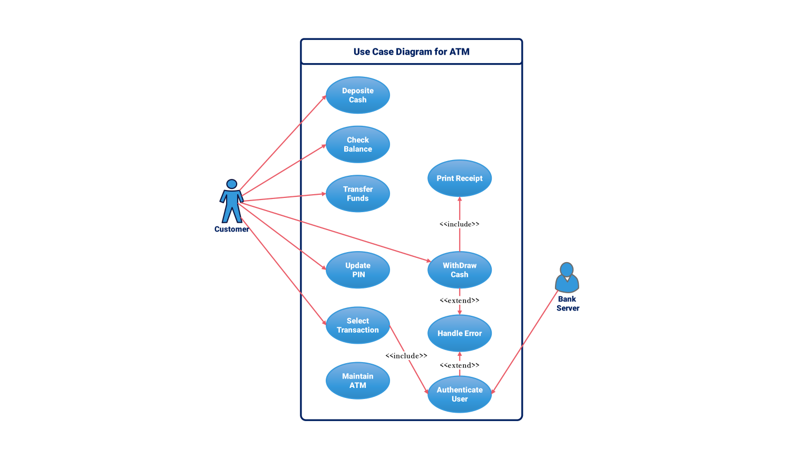

Slide 67
Data Flow Diagrams (DFD)
Represents how data moves through a system.
Components:
Processes (Circle)
Data Stores (Rectangle)
External Entities (Square)
Data Flows (Arrows)

Slide 68
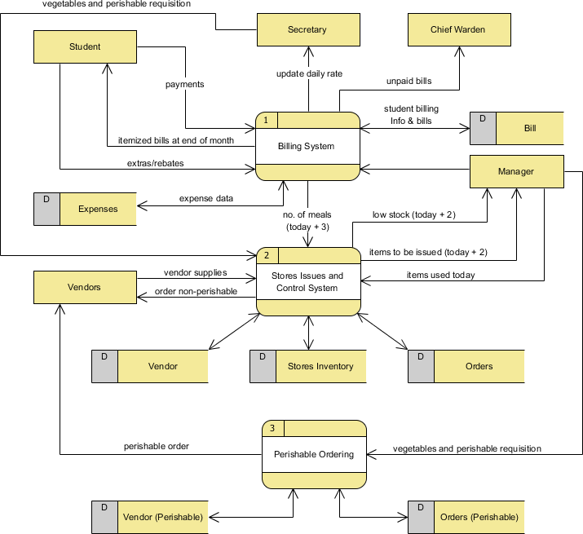

Slide 69
Entity-Relationship Diagram (ERD)
Definition: Diagram that models database structure.
Key Elements:
Entities (Objects like Students, Courses)
Attributes (Properties like Student Name, Course Code)
Relationships (Associations like Enrolled-In)

Slide 70
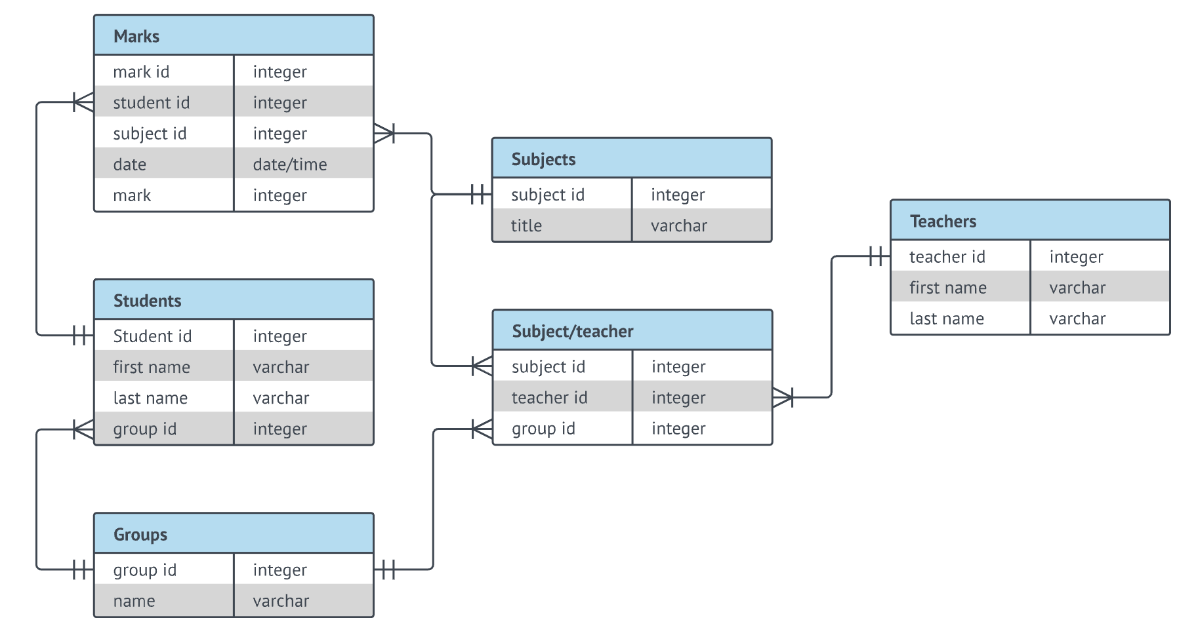

Slide 71
Analysis for Understanding the Domain and Requirements
Domain Analysis:
Identifying system environment, stakeholders, and constraints.
Techniques: Interviews, Questionnaires, Document Analysis.
Requirement Analysis Approaches:
Structured Analysis (DFD, ERD)
Object-Oriented Analysis (UML Diagrams, Class Diagrams)

Slide 72
Use Case Description Format
Use Case Name: Login Process
Actors: User, Authentication System
Preconditions: User must have an account
Main Flow:
User enters username and password.
System verifies credentials.
User is granted access.
Alternative Flow: Wrong password → Show error message.

Slide 73
Formal Specification
Definition: Mathematically-based techniques to specify software requirements.
Why is it useful?
Removes ambiguity.
Improves verification and validation.
Common Methods:
Z-Notation, B-Method, VDM (Vienna Development Method)

Slide 74
Benefits of Using Formal Specification
Precise and unambiguous.
Reduces misinterpretation.
Helps with system validation before development.

Slide 75
Challenges in Requirements Analysis
Common Issues:
Unclear or vague requirements.
Changing requirements.
Conflicting stakeholder interests.
How to overcome them?
Regular communication with stakeholders.
Using prototypes and visual models.

Slide 76
Real-World Example – Software Requirement Failure
Case Study: London Ambulance System Failure
System designed without clear requirements.
Lack of proper analysis led to incorrect dispatching.
Lesson: Proper requirement engineering prevents system failures.

Slide 77
Industry Best Practices in Requirements Engineering
Define SMART Requirements:
Specific, Measurable, Achievable, Relevant, Time-bound.
Use Requirement Management Tools:
JIRA, IBM Rational DOORS, ReqSuite.

Slide 78
Summary
Requirement Analysis ensures clear, complete, and correct requirements.
Modeling Techniques help visualize requirements for better understanding.
Use Case Modeling captures user interactions.
Formal Specification provides a rigorous, mathematical approach to defining requirements.

Slide 79
End of Topic 3

